Slide 2


Slide 3
Signage project had several goals
Make it easy for trail users in western PA to use trail signage
Eliminate the need for trail users to learn a new sign language every time they visit a new trail
Sign structures would be simple and clean in order to not detract from the beauty of the trail’s natural landscape or town streetscapes.
The sign panels and structure would be as “green” as possible within pricing constraints
Structures would require minimal maintenance and last a long time.
Structures would be designed so that volunteers could build them if trail organizations wished to assume that responsibility in-house
Notes:
Two for the trail users
Two for the environment
Two for the maintainers

Slide 4
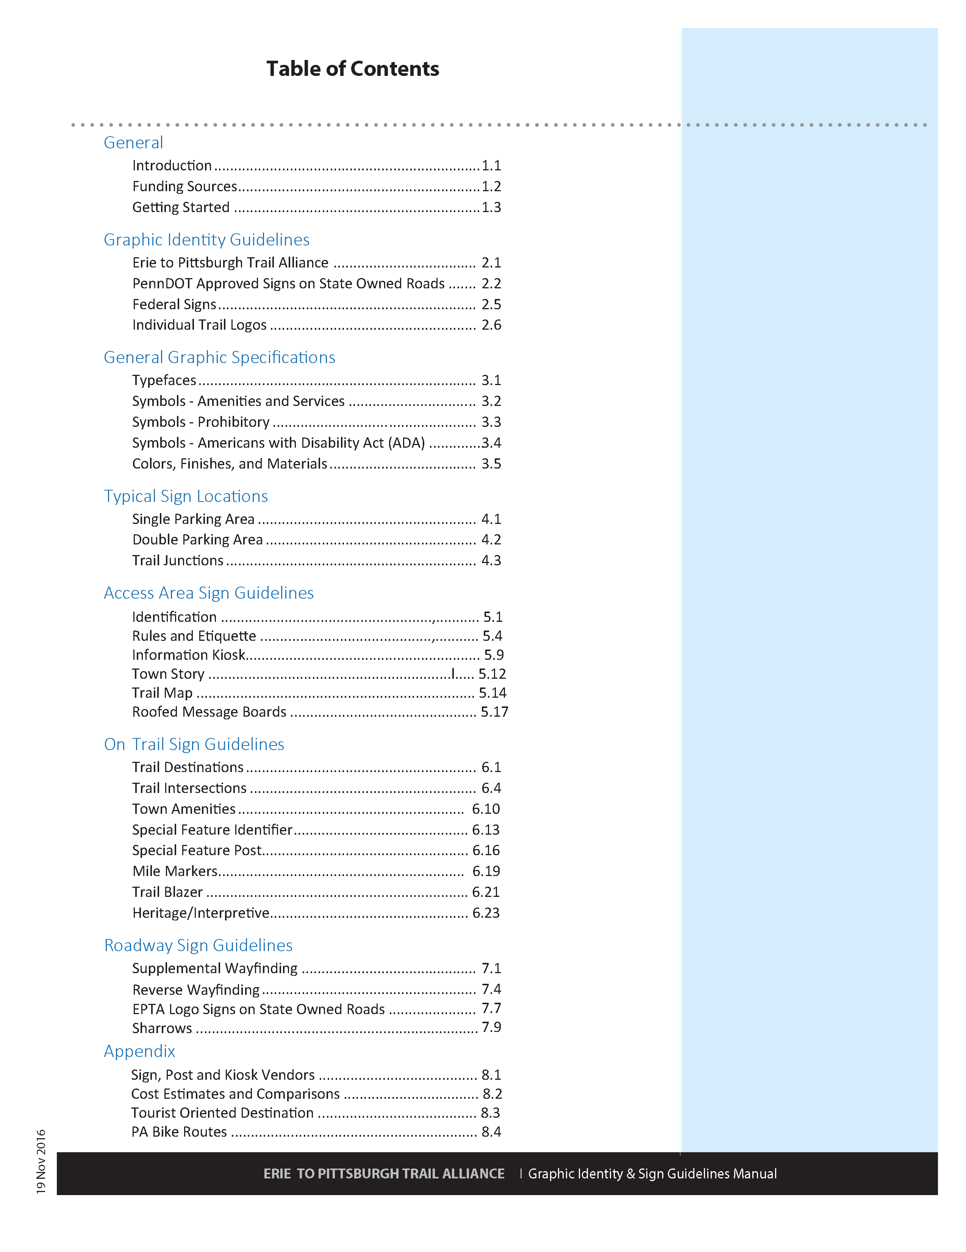
Notes:
Table of contents. 89 pages in all like to so is step through the 8 sections, and ultimately show you some of the signs

Slide 5
General
Introduction
Funding Sources
Getting Started
Notes:
First section s kind of general, typical fluff you see at the start of such a document.

Slide 6
Graphic Identity Guidelines
Erie to Pittsburgh Trail Alliance
PennDOT Approved Signs on State Owned Roads
Federal Signs
Individual Trail Logos
General Graphic Specifications
Type faces
Symbols - Amenities and Services
Symbols - Prohibitory
Symbols - Americans with Disability Act (ADA)
Colors, Finishes, and Materials
Notes:
Next section logos, next section overall specifications – more reference that anything else.

Slide 7
Typical Sign Locations
Single Parking Area
Double Parking Area
Notes:
Get into the part where decisions are made

Slide 8
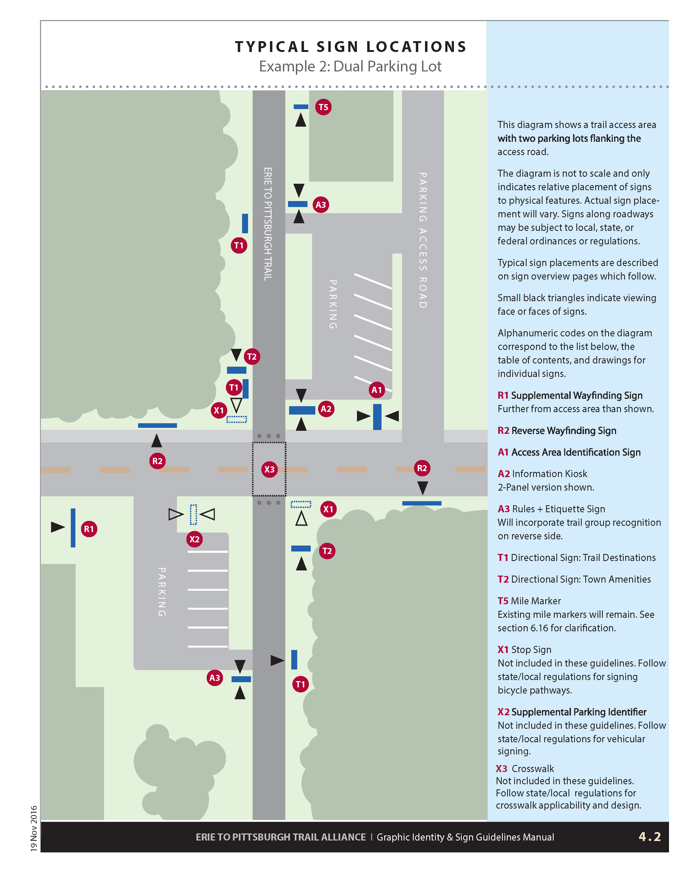
Notes:
Many places to consider for sign locations, 15 to 20

Slide 9
Various Sign Locations
Access Area Signage
On Trail Signage
Roadway Signage
Notes:
Next three section show various signs- split into three location types

Slide 11
Appendix
Sign, Post and Kiosk Vendors
Cost Estimates and Comparisons
Tourist Oriented Destination
PA Bike Routes
Notes:
Vendor - asking for input, cost “cost of total Ownership” both $$ and Maintenance more upfront to eliminate $$ , hours

Slide 12
The Erie to Pittsburgh Trail Alliance (EPTA) gratefully acknowledges that this manual is adapted directly, with permission, from the Allegheny Trail Alliance manual. Changes have been made to replace the ATA logos and colors with the EPTA logos and colors.

Slide 13
Questions signmanual.eriepittsburghtrail.org

