Slide 1
Neville Street Working Group
Look for ways to improve
Pedestrian/Bicycle access from
Fifth Ave to Junction Hollow Trail
Along Neville/Boundary St
Notes:
What
And mission

Slide 3
Fifth Ave
Forbes Ave
Schenley Dr
Joncaire St
Trail Entrance
Notes:
Over all view of where

Slide 4
Committee was formed because:
Notes:
Why

Slide 5
Committee was formed because:
This roadway is unsafe for bicyclists and pedestrians

Slide 6
Committee was formed because:
This roadway is unsafe for bicyclists and pedestrians
It is being heavily used by bicyclists and pedestrians

Slide 7
Committee was formed because:
This roadway is unsafe for bicyclists and pedestrians
It is being heavily used by bicyclists and pedestrians
There are a number of active projects in the area

Slide 8
Committee was formed because:
This roadway is unsafe for bicyclists and pedestrians
It is being heavily used by bicyclists and pedestrians
There are a number of active projects in the area
CMU Neville street parking area (completed)

Slide 9
Committee was formed because:
This roadway is unsafe for bicyclists and pedestrians
It is being heavily used by bicyclists and pedestrians
There are a number of active projects in the area
CMU Neville street parking area (completed)
Central Catholic STEM building (sidewalk completion this summer)

Slide 10
Committee was formed because:
This roadway is unsafe for bicyclists and pedestrians
It is being heavily used by bicyclists and pedestrians
There are a number of active projects in the area
CMU Neville street parking area (completed)
Central Catholic STEM building (sidewalk completion this summer)
CMU Tupper building (loading dock completion this winter)

Slide 11
Committee was formed because:
This roadway is unsafe for bicyclists and pedestrians
It is being heavily used by bicyclists and pedestrians
There are a number of active projects in the area
CMU Neville street parking area (completed)
Central Catholic STEM building (sidewalk completion this summer)
CMU Tupper building (loading dock completion this winter)
OPDC would like to facilitate coordination among the adjacent projects

Slide 12
Lets talk detail

Slide 13
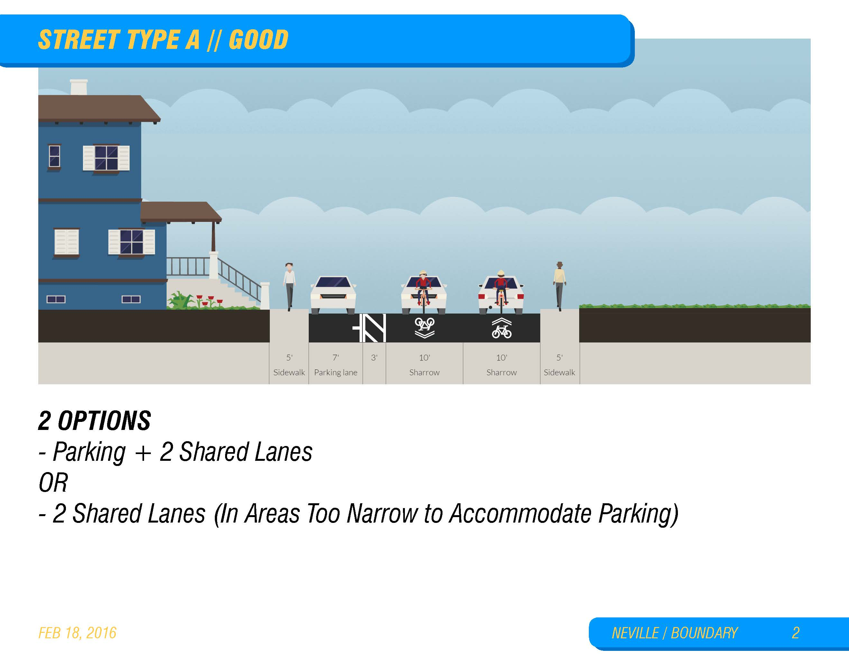

Slide 14
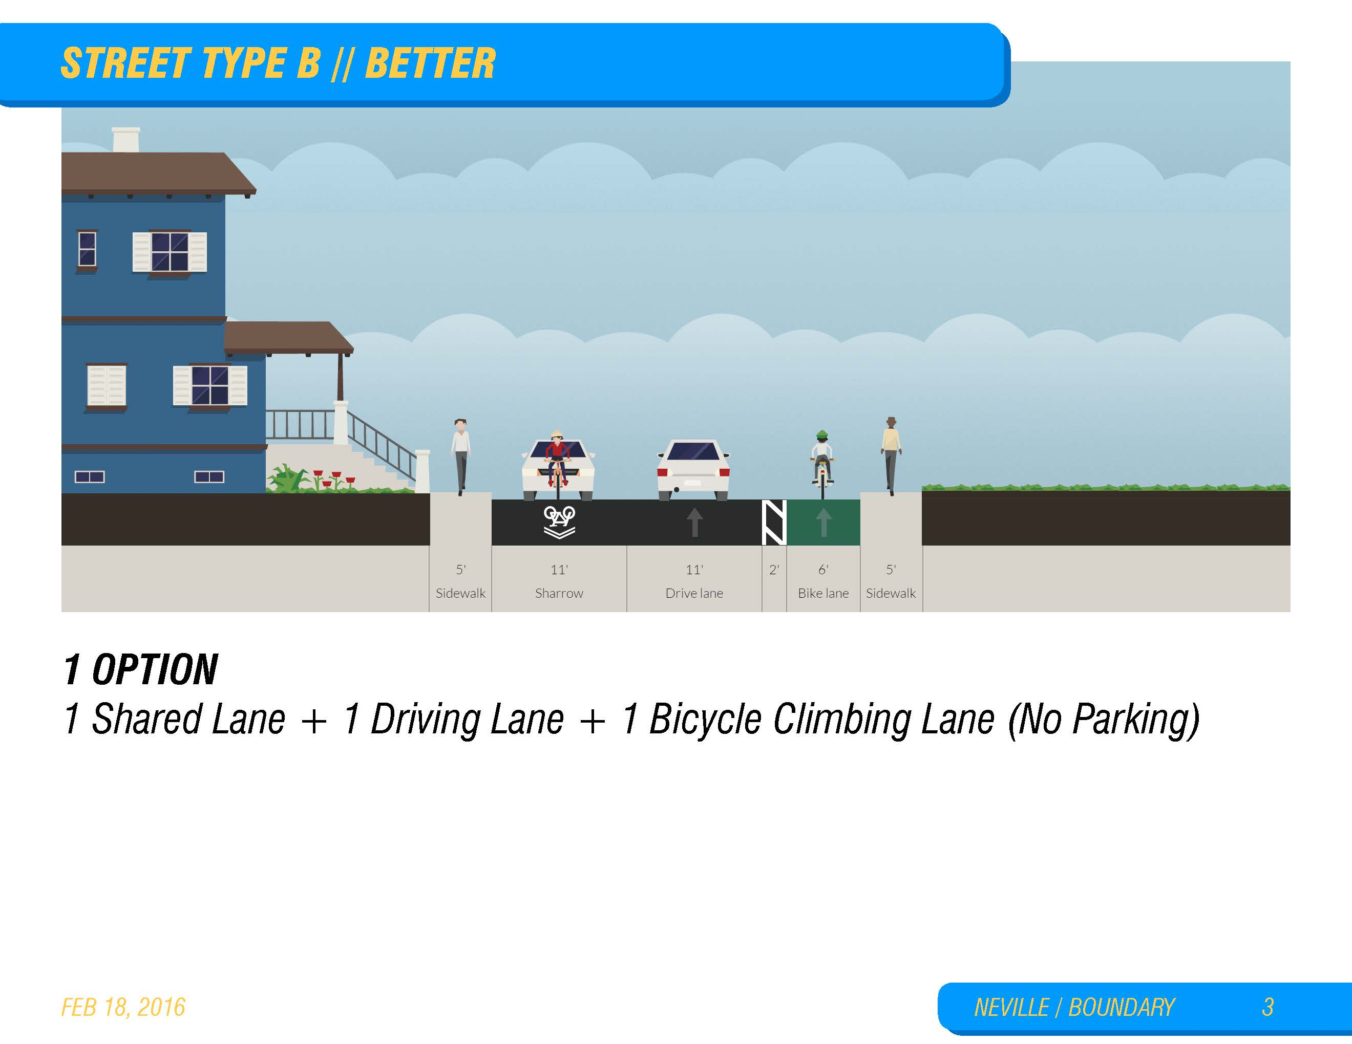

Slide 16


Slide 17
Notes:
Schenley drive road overhead
Jonciare Street
Trail entrance

Slide 18
Current Thoughts
Notes:
Where we are going
Ideal solution

Slide 19
Notes:
Up hill shared use path on east side of street
Down hill sharrows in street

Slide 20
Notes:
Right angle crossing of railroad tracks
Between CMU parking and the railroad

Slide 22
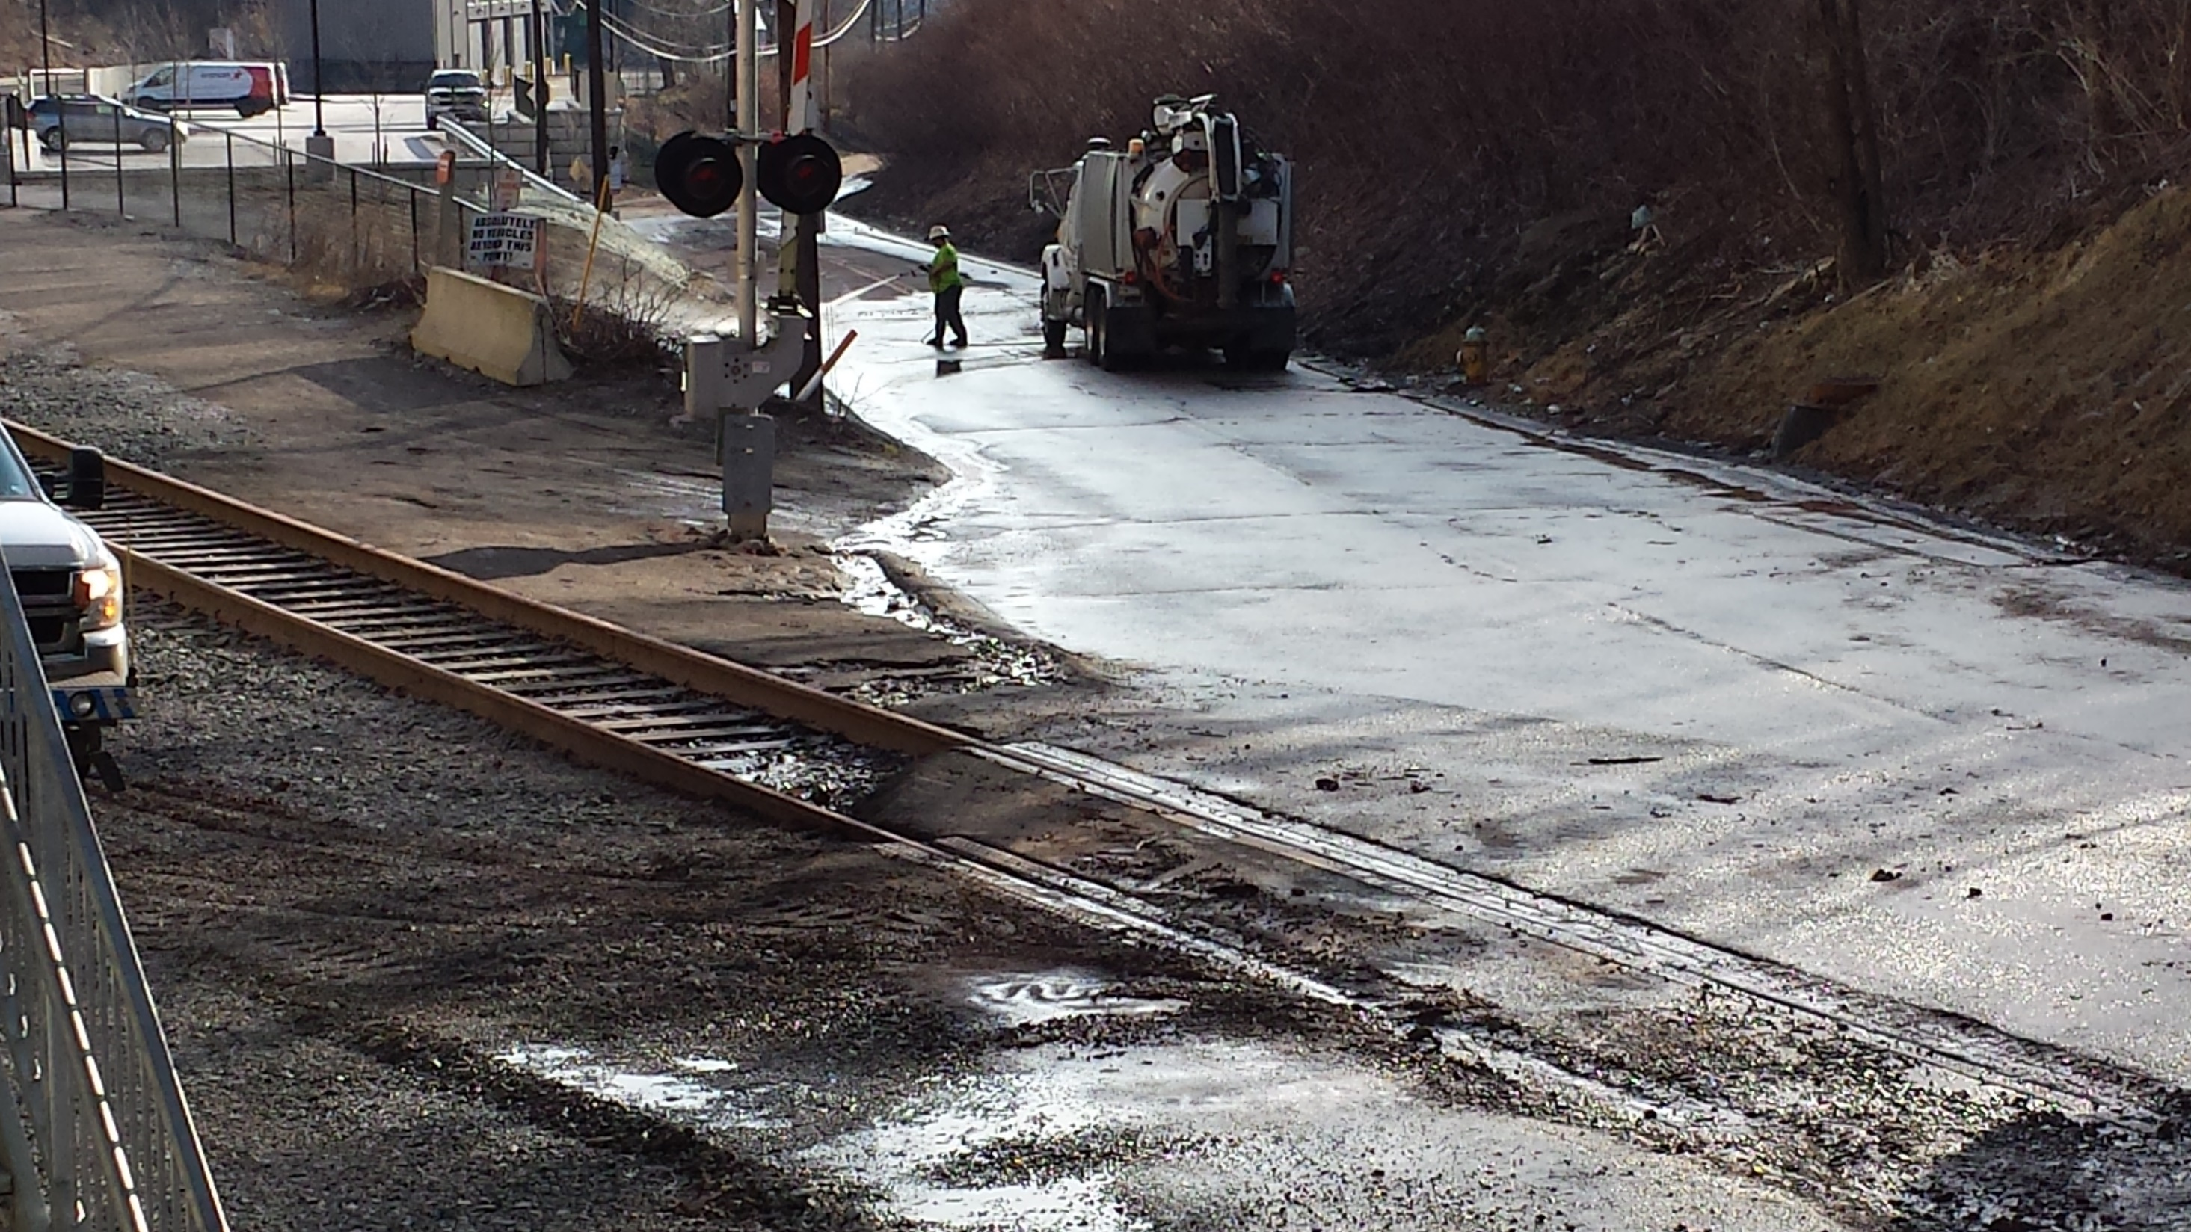

Slide 23
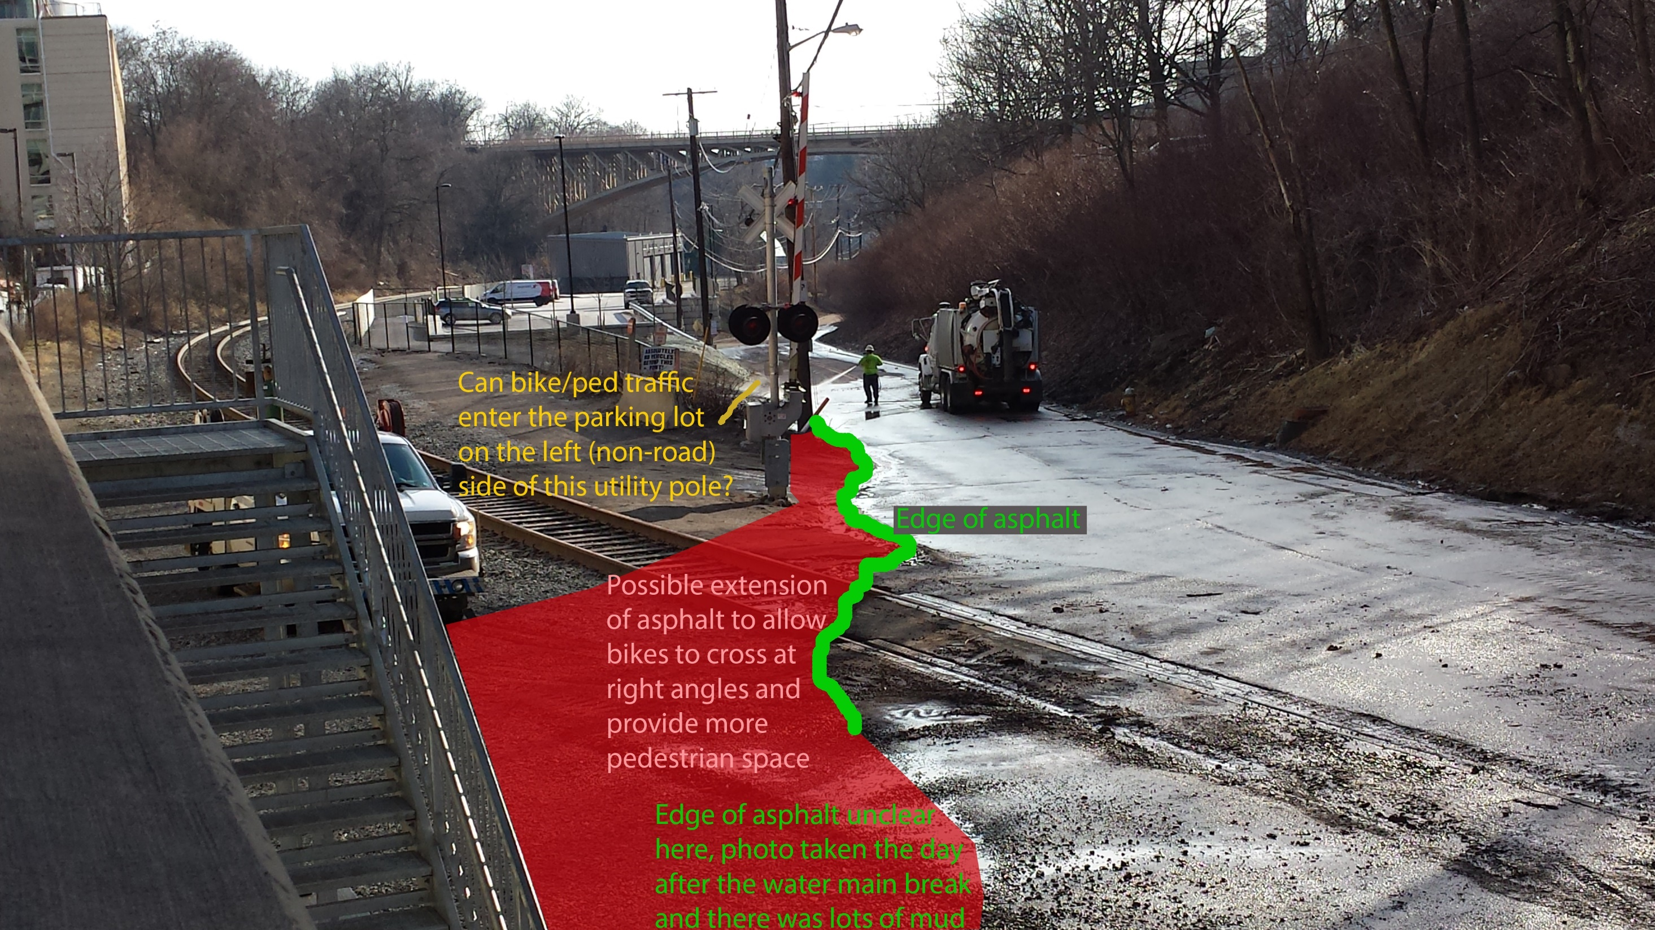

Slide 24
Notes:
Right angle crossing of railroad tracks
Between CMU parking and the railroad

Slide 25
Notes:
Between rail road and the cliff

Slide 27
Questions - Comments
Notes:
CMU and CC are engaged
Pinch point is the railroad crossing
Rail road is an issue

Slide 29
Committee Members
Bob Harper
Bruce Chan
David Zwier
Karen Brooks
Mary Shaw
Roy Weil

